Slide 1
Portal Advanced Features
Sites, Layouts, Navigation, Portlets

Slide 2
Sites Sites creation and urls

Slide 3
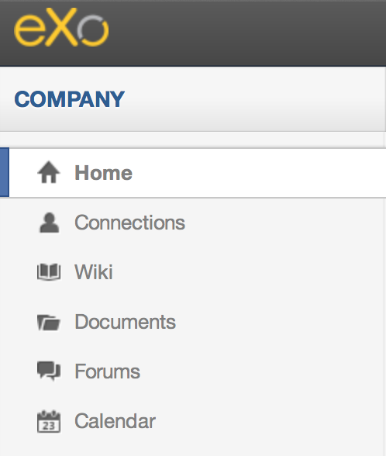
Sites
You can manage several sites in eXo.
By default, there is only “intranet”
Each site consists of a navigation nodes (=menu entries), pages and a common site layout.
The site intranet has the navigation entries “Home”, “Connections”, “Wiki”, etc

Slide 4
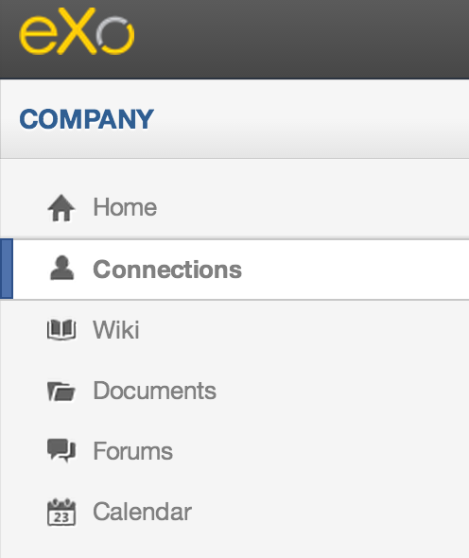
Sites
The site layout defines the layout of the common part of all pages of a site. Normally there are a common header and common footer.
In this example the current site is is called “intranet”.
The different pages are opened by clicking on the navigation nodes “Home”, “Connections”, “Wiki” which opens the corresponding pages.
Later on, we will see how navigation nodes and pages are logically separated.

Slide 5
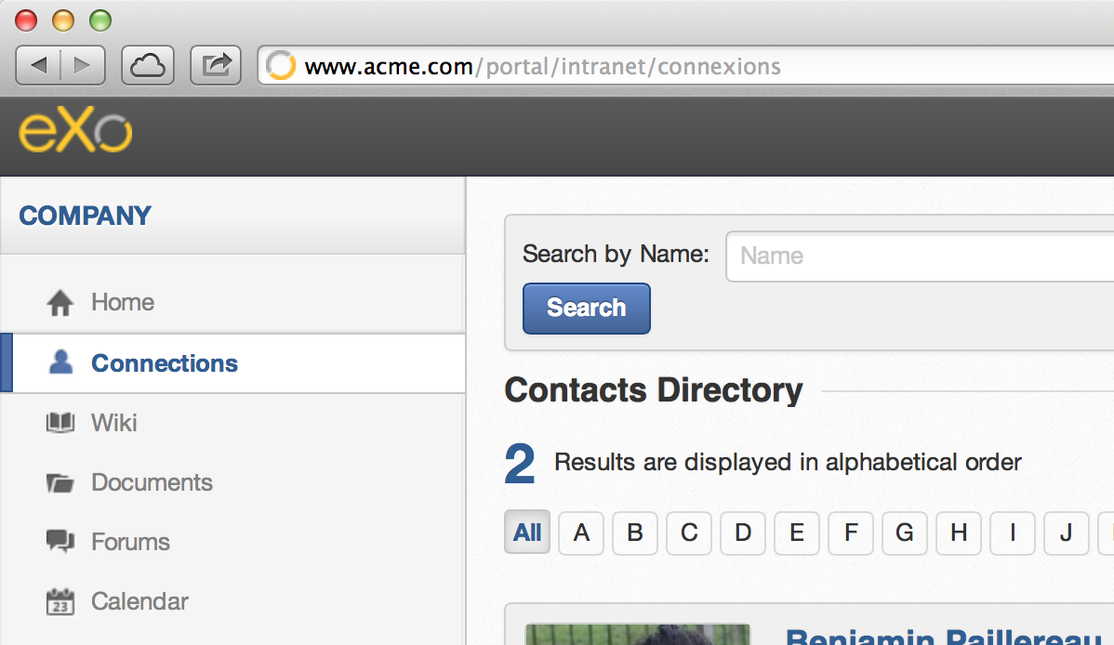
Site
The URL is composed of the current site and the chosen navigation node
<site>/<navigation>
Current page

Slide 6
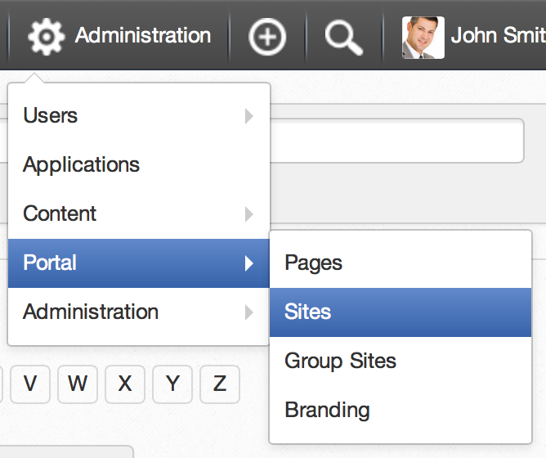
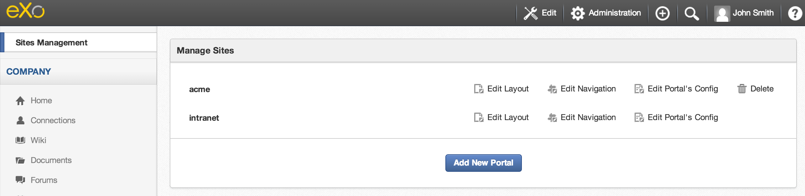
Manage your sites
You can manage several sites.
Sometimes the terms “site” and “portal” are interchanged.
Each site has its own layout, navigation, pages and properties.
You cannot delete the default site
Create a new site/portal

Slide 7

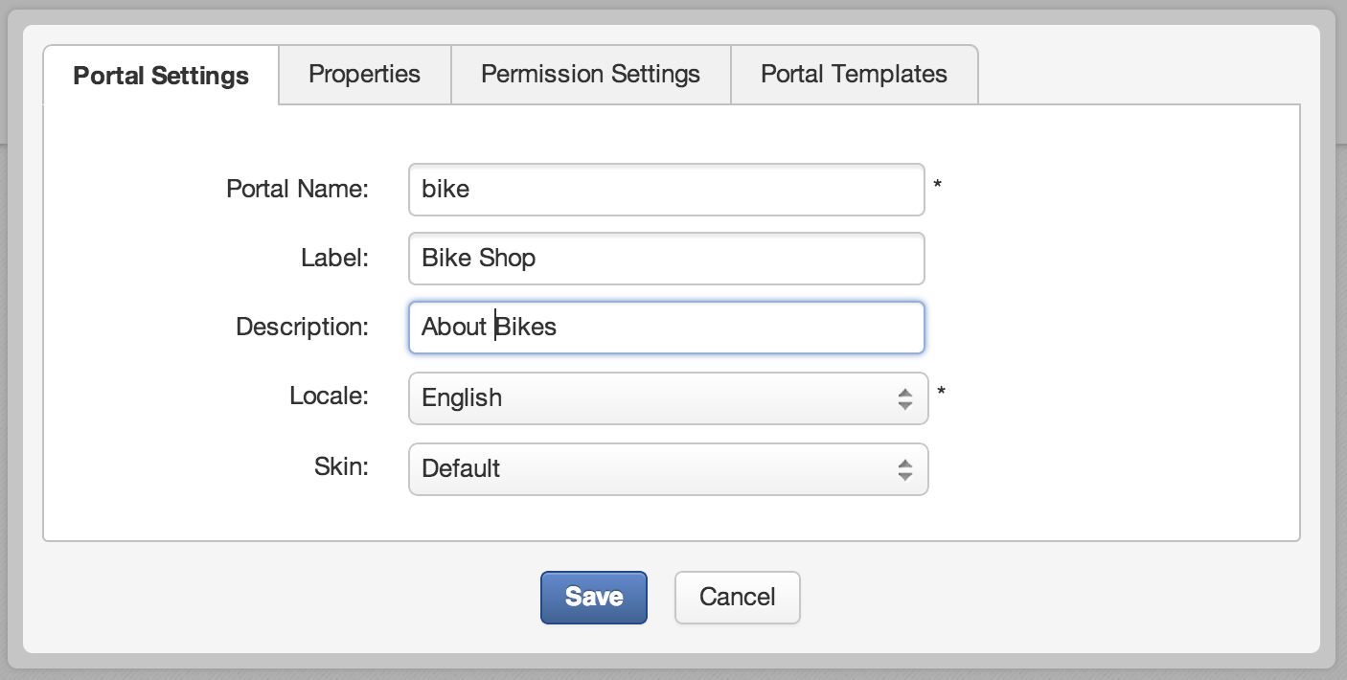
Manage your Sites – Portal Settings
Click on “Add New Portal” and choose a name, locale and skin for your site.

Slide 8
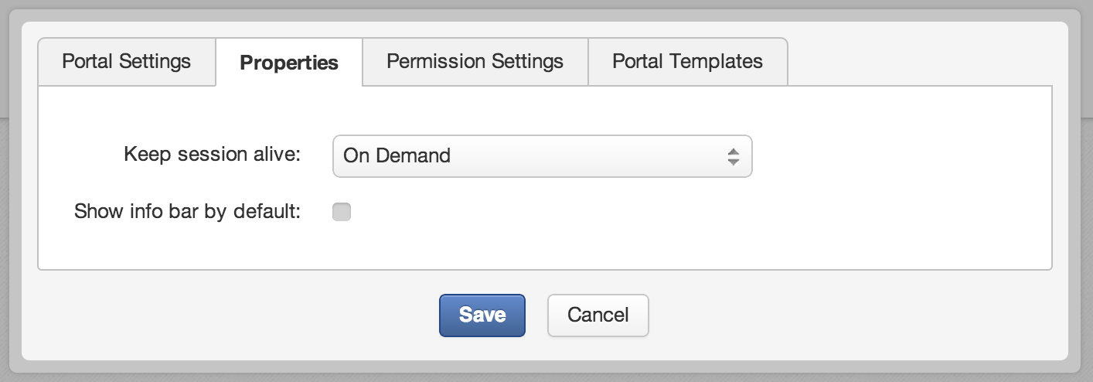
Manage your Sites – Properties
Check if you generally need decorations around the portlets. 95% of the customers do not need this.

Slide 9
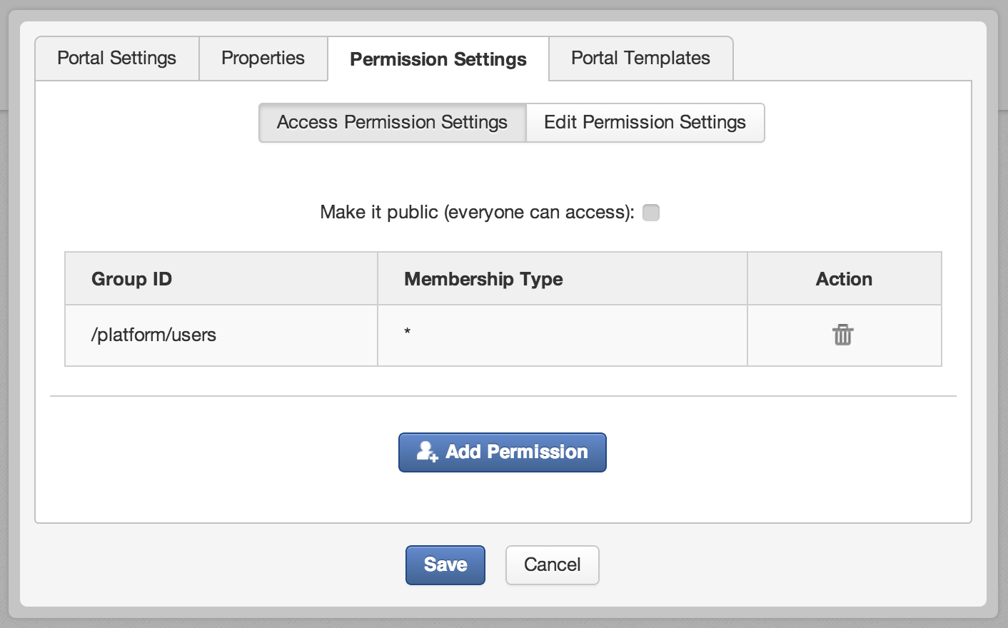
Manage your Sites – Permissions Settings
Add more groups that will have access permission.

Slide 10
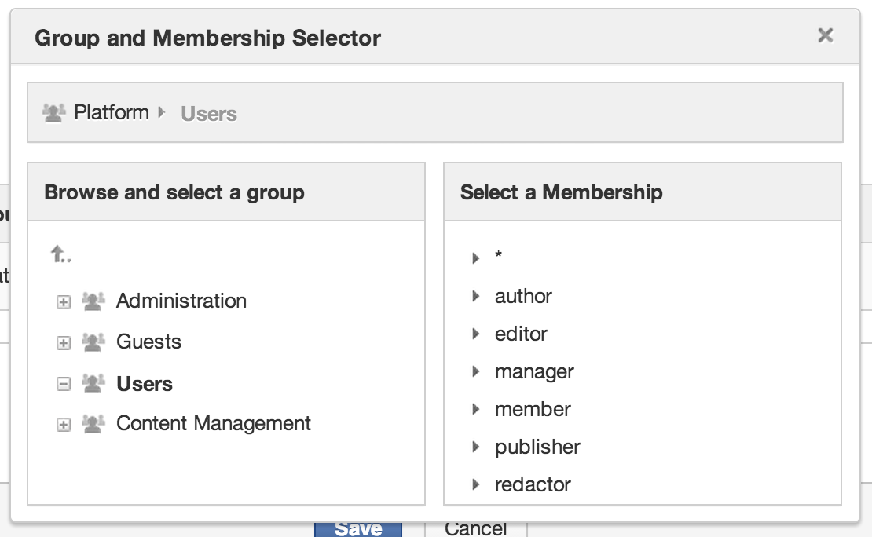
Manage your Sites – Permission Selector
Permission Selector

Slide 11
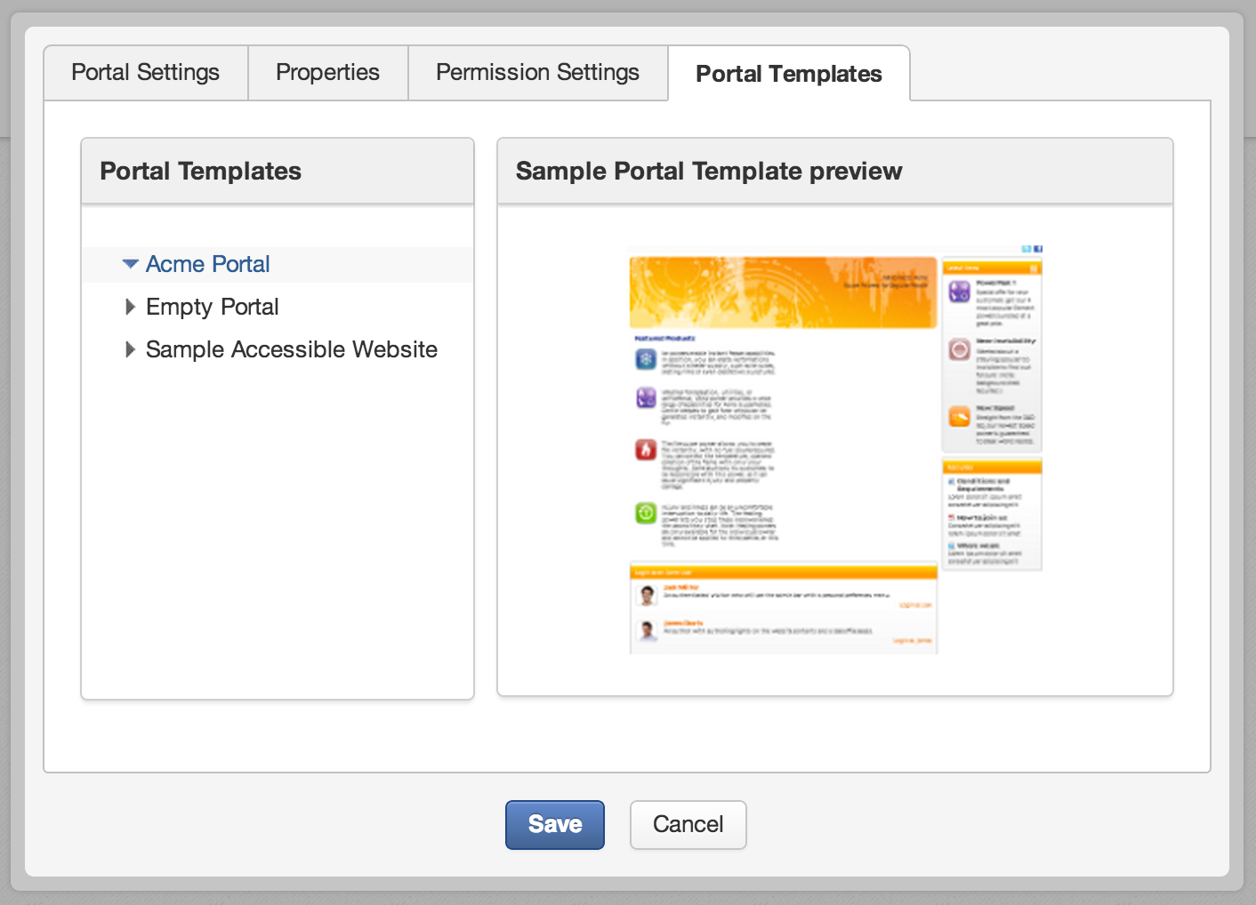
Manage your Sites – Sites templates
One template by default (empty). It can be extended using Extension mecanism

Slide 12
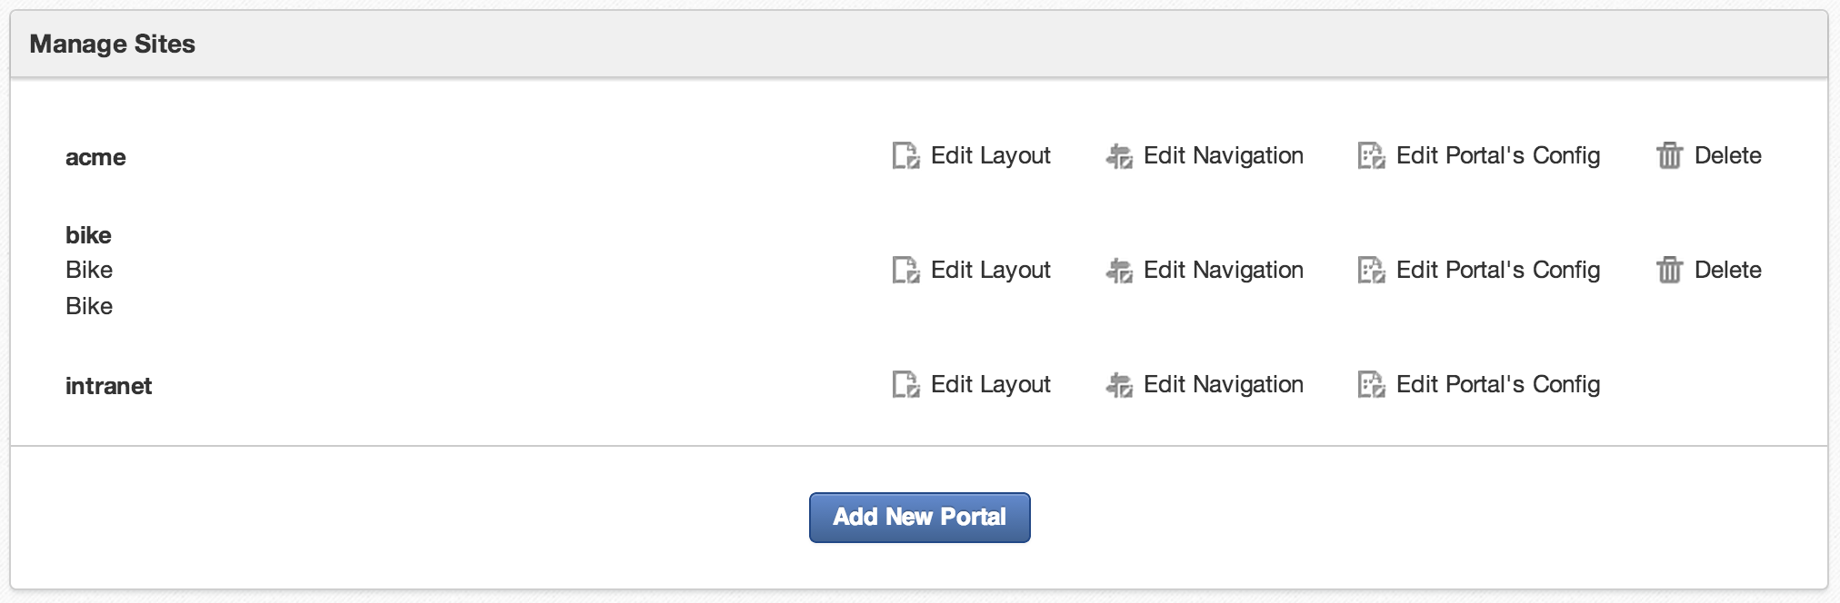
Manage your Sites – Sites templates
The new site appears in the Sites list

Slide 13
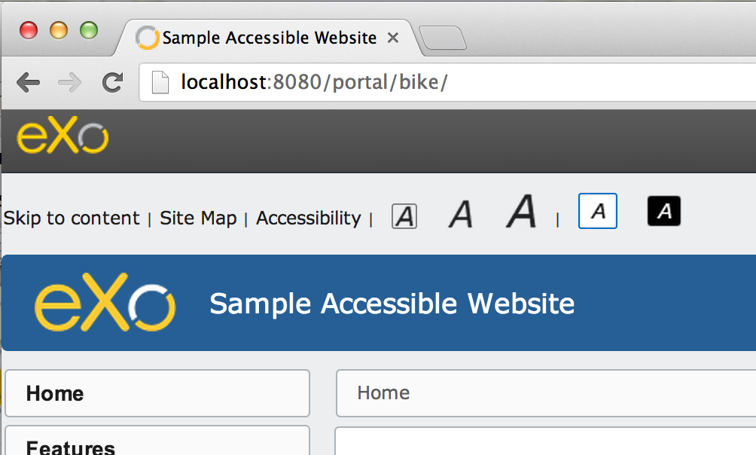
Manage your Sites – Sites templates
You can access your site by its url : /portal/bike

Slide 14
Exercise

Slide 15
Exercise 1 : Start and Play
Start the portal with extensions
Search for the binary subfolder:
...\platform-4.0.0
In command line, launch:
Linux / Mac OS : ./extension.sh
Windows : extension
Install acme (required for training), wai, ide and crash
Linux / Mac OS : ./extension.sh -i acme
Windows : extension -i acme
Start eXo, then open this page in a browser: http://localhost:8080

Slide 16
Exercise : New Site (15 minutes)
Create a new Site and manage its permissions
Login as John.
Administration > Portal > Sites and add a new site (or portal) called “bike”.
Allow access to everyone. Gives edit rights anybody in the group “platform/users”. (Platform/Users)
Choose the “Acme Portal” template.
Save.
Warning: Careful, by mistake you might exclude yourself from your new site: For example, give the edit rights to “platform/bike” only. If you are not part of this group you will not see the new site in the “Manage Sites” interface anymore – in order to see the site again you have to add your user to the group.

Slide 17
Layout For sites and pages

Slide 18
Site Layout
There a several different pages on a site. Each page has its own URL.
The site layout defines the layout of the common part of all pages of a site. Normally there are a common header and common footer.
A layout consists of a set of containers and applications.
The layout of a single page consists of the headers and footers of the site layout together the page layout.

Slide 19
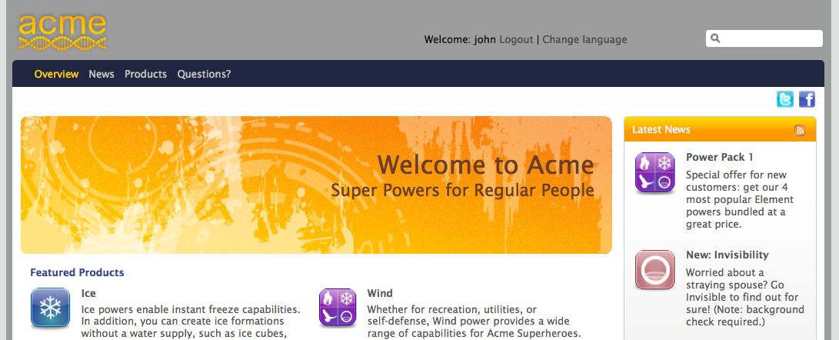
Site Layout
Common header layout of all pages of the site “acme”
In blue color: Layout of the page “Overview”

Slide 20
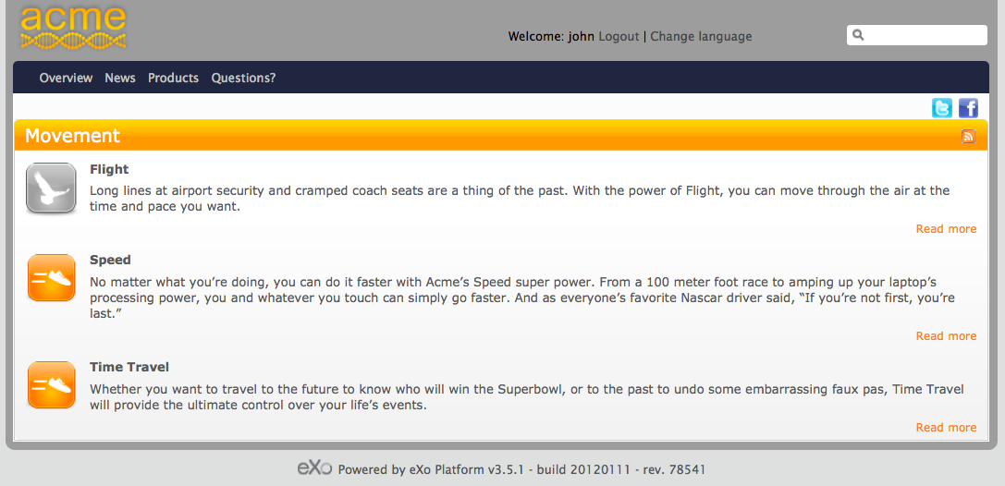
Site Layout
Common header layout of all pages of the site “acme”
In blue color: Layout of the page “Products” (Showing Movement)
Common footer layout of all pages of the site “acme”

Slide 21
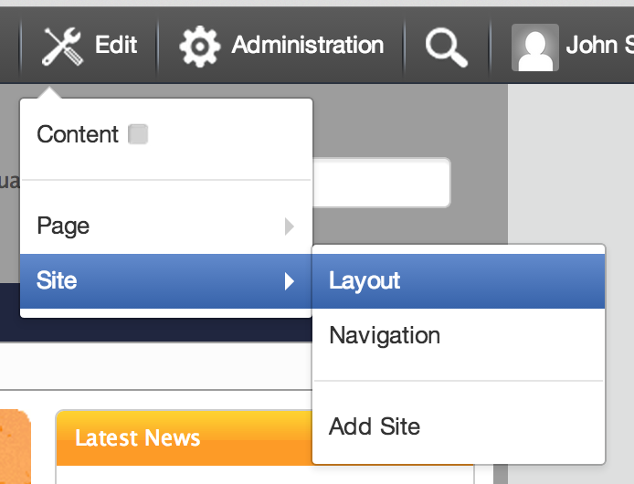
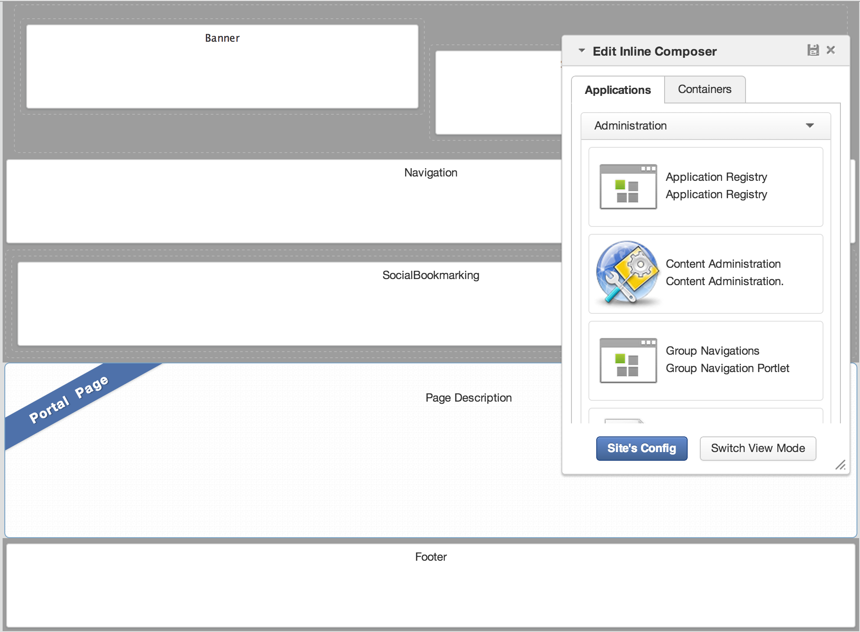
Site Layout
Page Marker

Slide 22
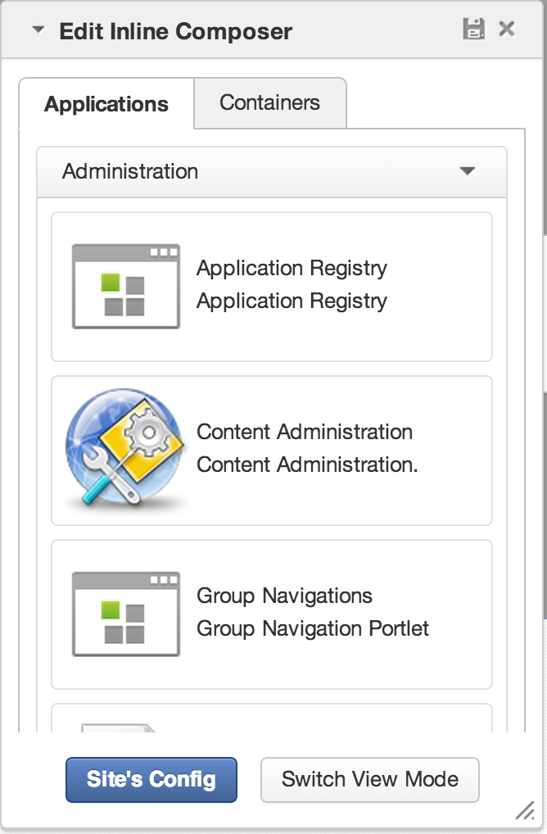
Applications
Categories
Organized in categories
Configurable in the application registry (later chapter).
Drag and drop an application from the page editor to the page: In that moment you create a new instance of the portlet.
The page editor shows an applications and a containers tab. Clicking on these tabs switches also the between an application and a container mode.
Applications

Slide 23
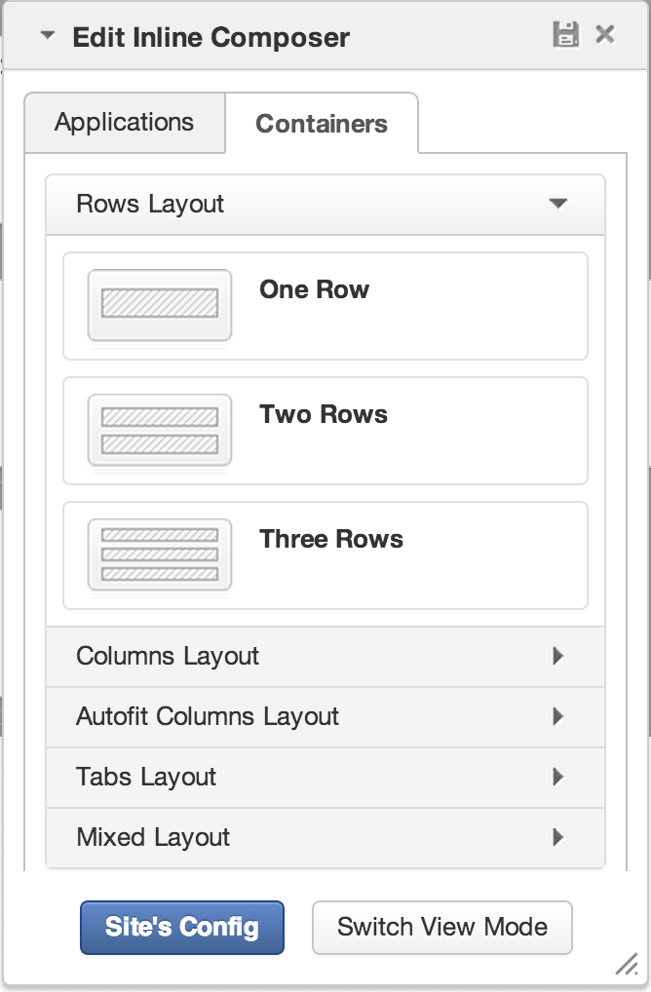
Containers
Containers help to position elements on the page.
Most containers are invisible in the final page.
You can use them in :
Page layout
Portal layout
You can combine different containers.

Slide 24
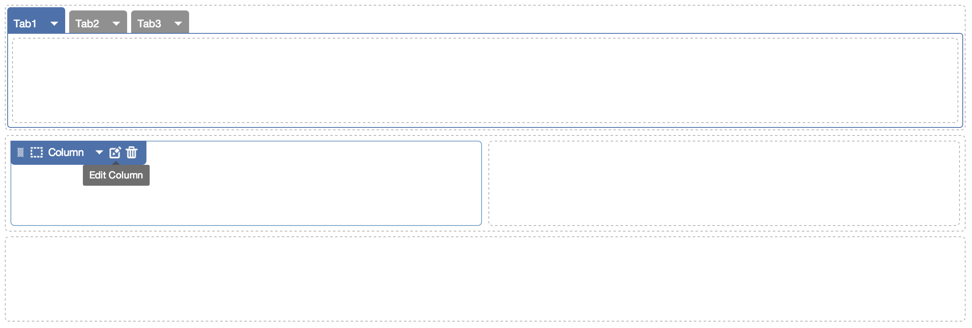
Containers
Container Combination

Slide 25
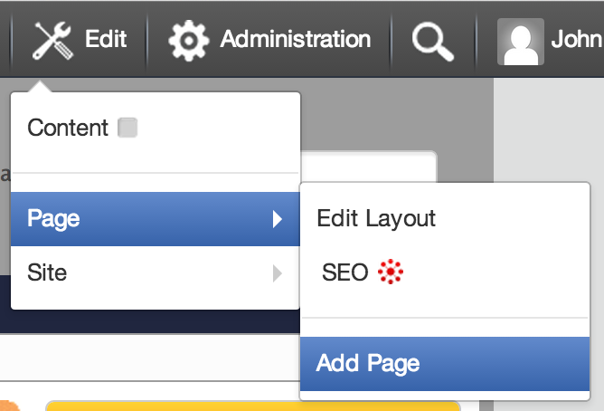
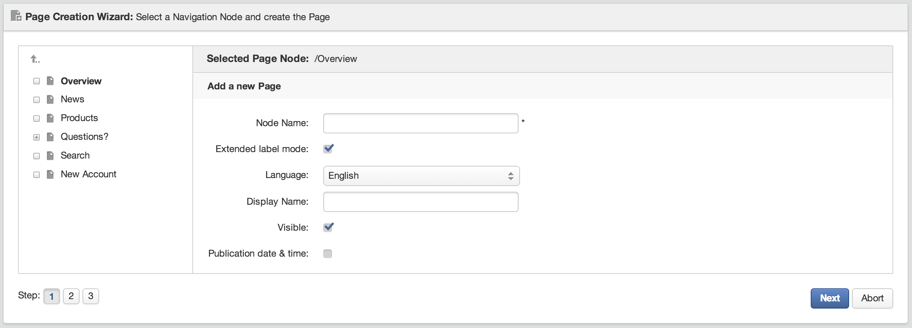
Add New Page
Current Parent Node
Go to root node
Invisible pages do not appear in the menu, they are useful for search results or print viewers.

Slide 26
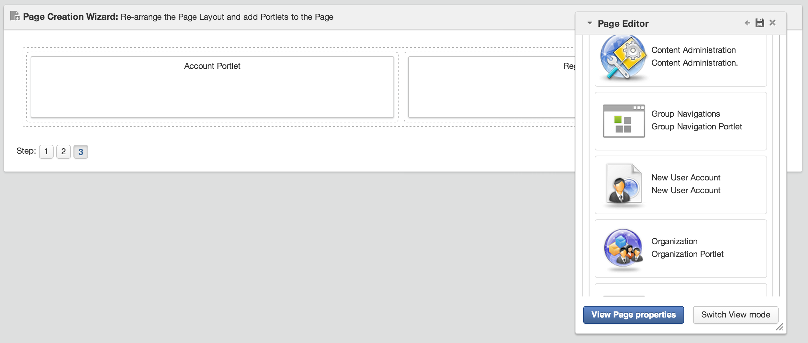
Add New Page
Fill the page with Containers and Applications
Save or Cancel

Slide 27
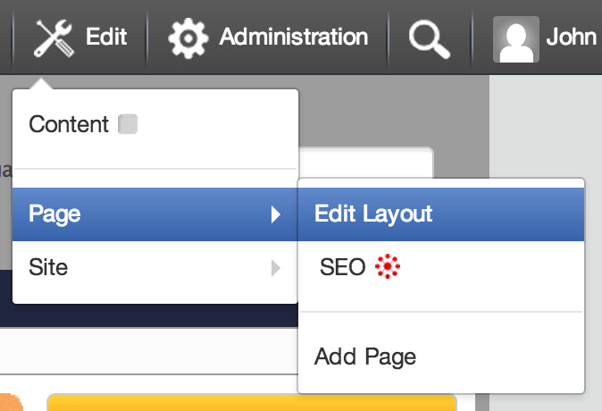
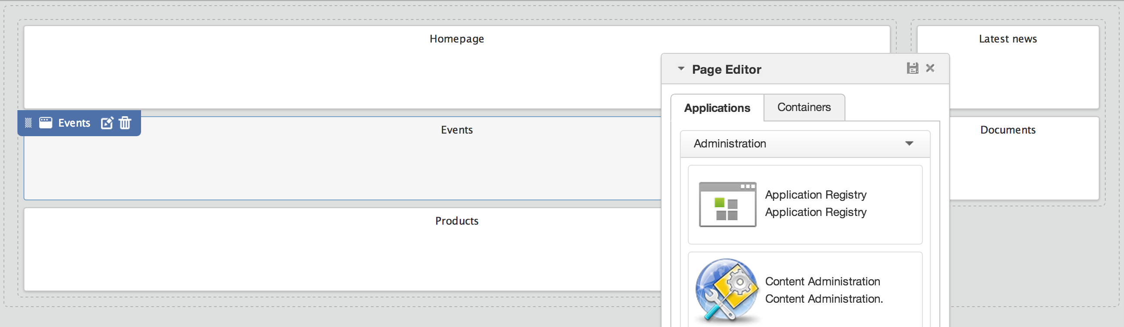
Edit Page Layout
Add new applications or containers
Edit Applications

Slide 28
Exercise 1/2 : Layout (20 minutes)
Page Layout
Login as John. Go to the home page of the bike site.
Click on “Add Page” and browse to the root of the navigation (gray arrow).
Call the new bike “Bike Shop”.
Add at least one application to the page (otherwise it won’t show up). Save.
Go to the new page of the bike site. Click on Edit → Page → Edit Layout.
Drag a three tabbed container in the layout.
Drag some applications in the container tabs.
Save.
Switch between your pages “Bike Shop” and the home page.

Slide 29
Exercise 2/2 : Layout
Portal Layout
Click on the bike homepage, then on “Edit Layout”, modify the layout of the portal.
Save.
Switch between the homepage and “Bike Shop” page in order to see the differences.

Slide 30
Portlets Preferences and Settings

Slide 31
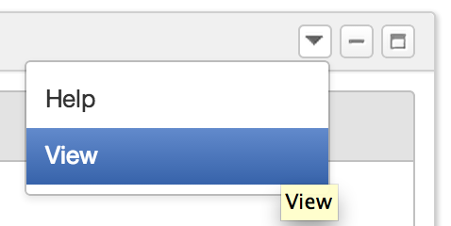
Portlets
Portlet : A rectangular bloc which allows to access to a content or a service.
Each portlet has some preferences, settings and decorations.
The portlet can be positioned in any place of a page.
You can reuse the same portlet several times: Then we say there are several instances of the same portlet.
Each instance of the same portlet can be configured differently.
Window decoration (optional)
Window states: maximized, minimized
Portlet Modes: view, edit, help
The combination of a portlet instance + preferences + decorations is also called an “application”.

Slide 32
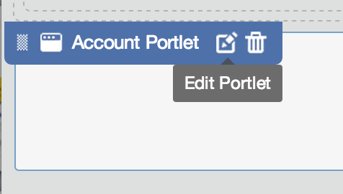
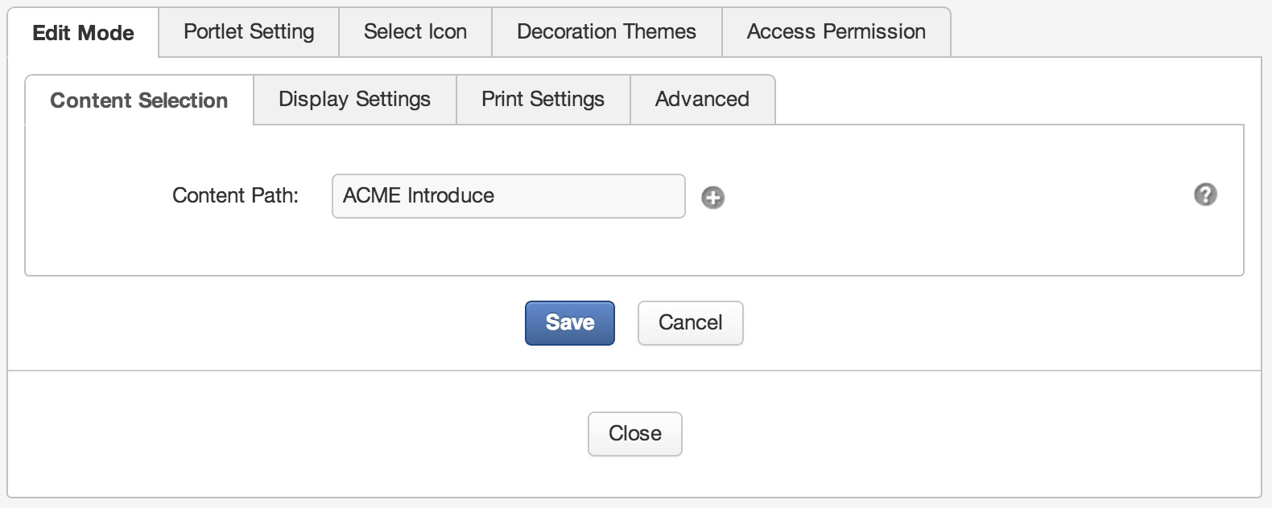
Portlet Preferences and Settings
In the page layout, go hover a portlet and click on the pencil
The first tab (Edit Mode) depends on the portlet, therefore it’s different for each portlet. This tab is optional.

Slide 33
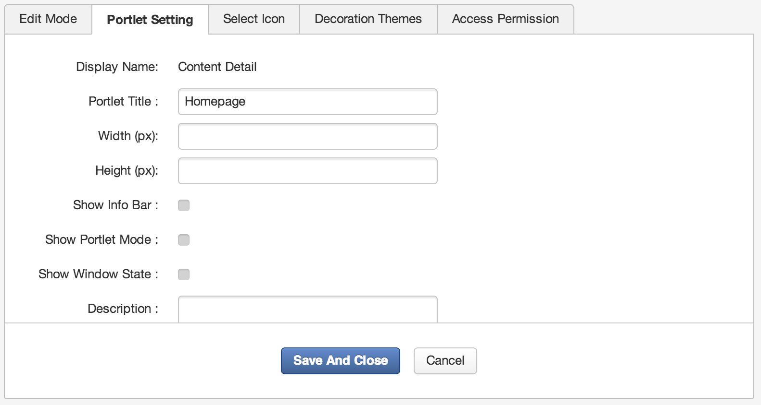
Portlet Preferences and Settings
Check if you need decorations. You can uncheck this by default at the site options.

Slide 34
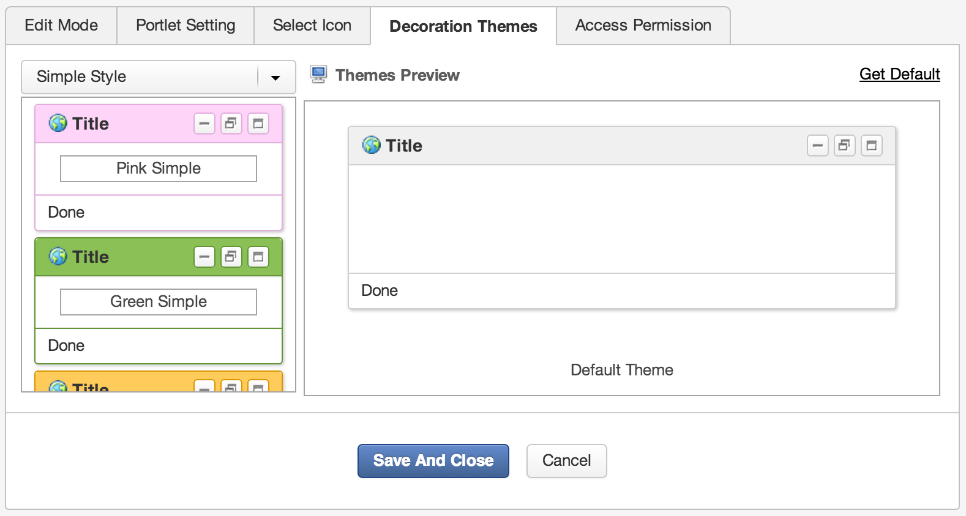
Portlet Preferences and Settings

Slide 35
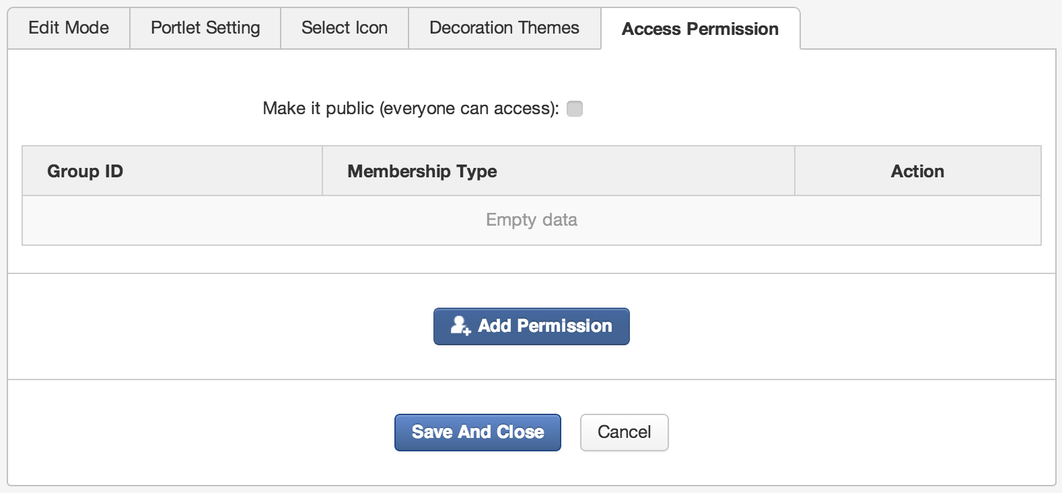
Portlet Preferences and Settings

Slide 36
Navigation Nodes Pointing to pages

Slide 37
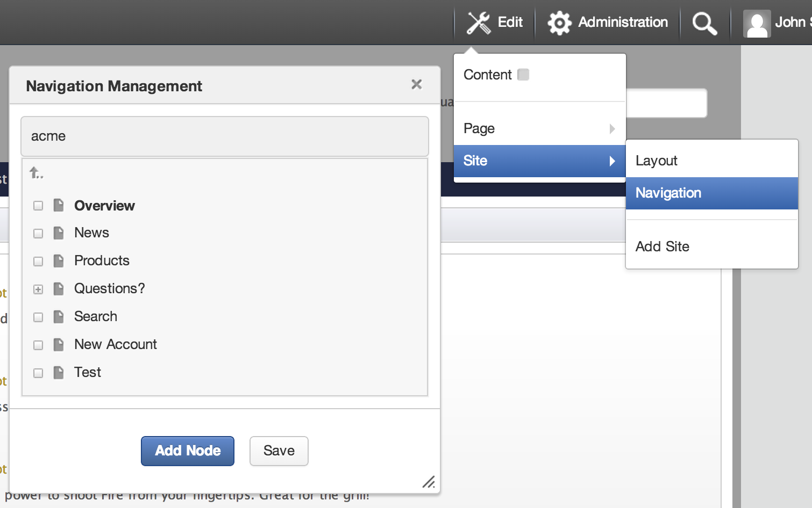
Navigation
Manage access to portal pages
Hierarchy structure of navigation nodes
Each node references a page
Aggregation types: site, group, user
Navigation portlet: Represents the navigation in a menu

Slide 38
Navigation
Visible nodes of the navigation
Invisible nodes of the navigation

Slide 39
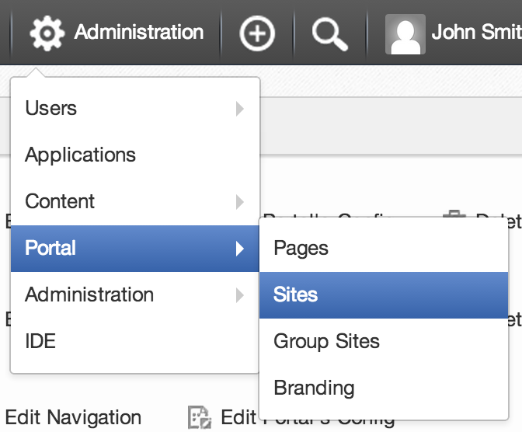
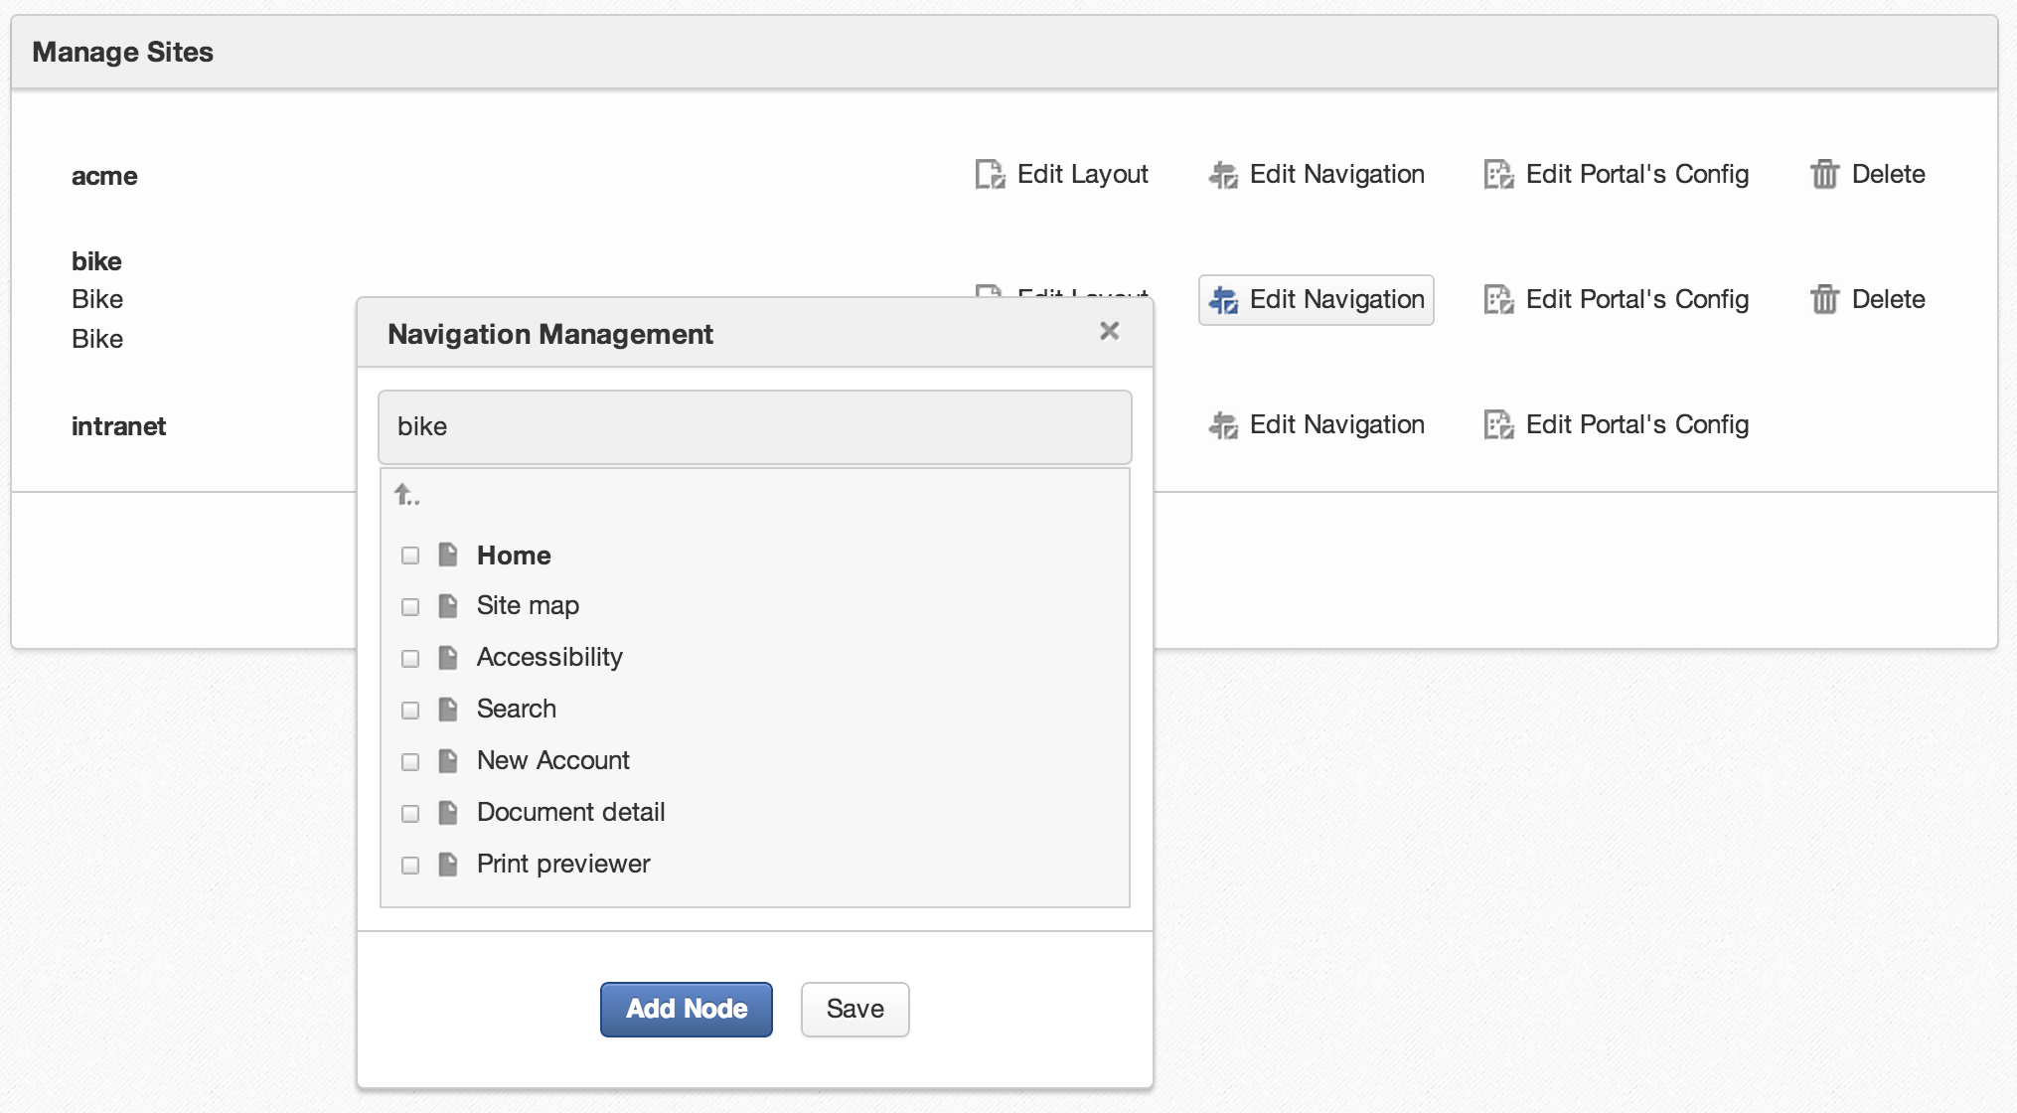
Navigation
Administration > Sites

Slide 40
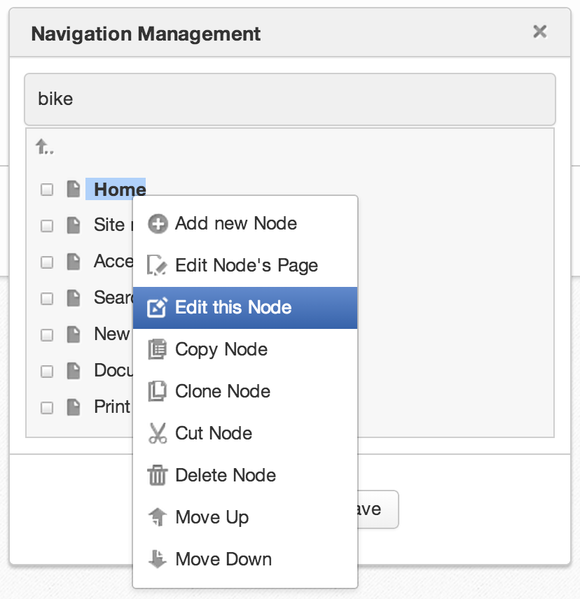
Navigation - Edit
Go to Parent node
Right click on node to show actions

Slide 41
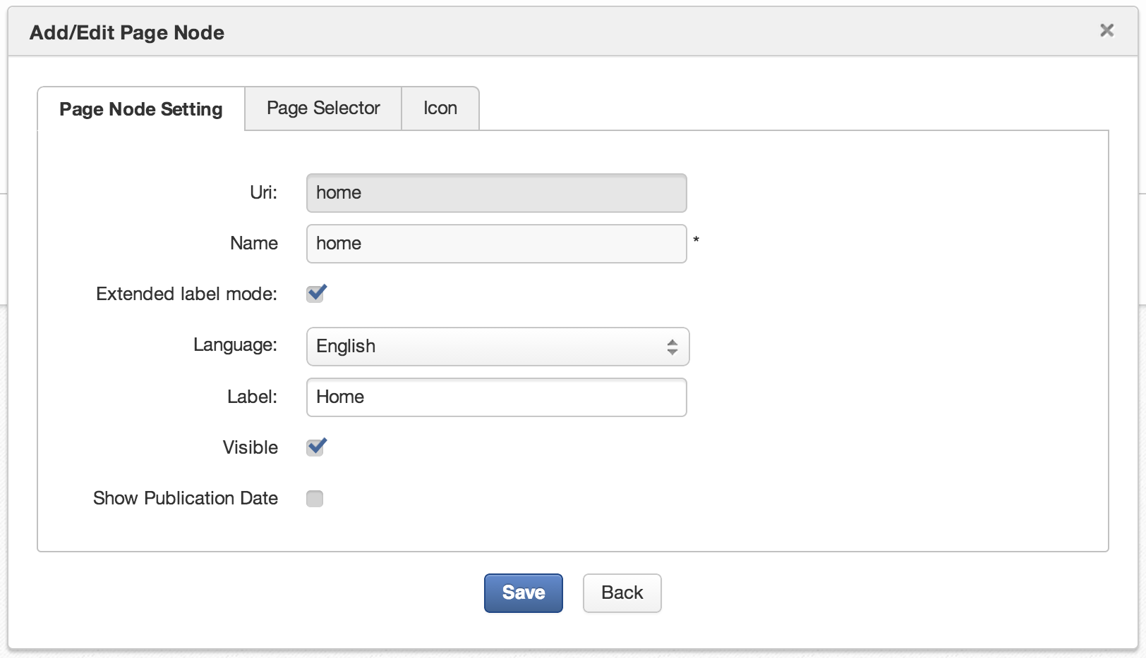
Navigation – Edit Node
Used in the URL

Slide 42
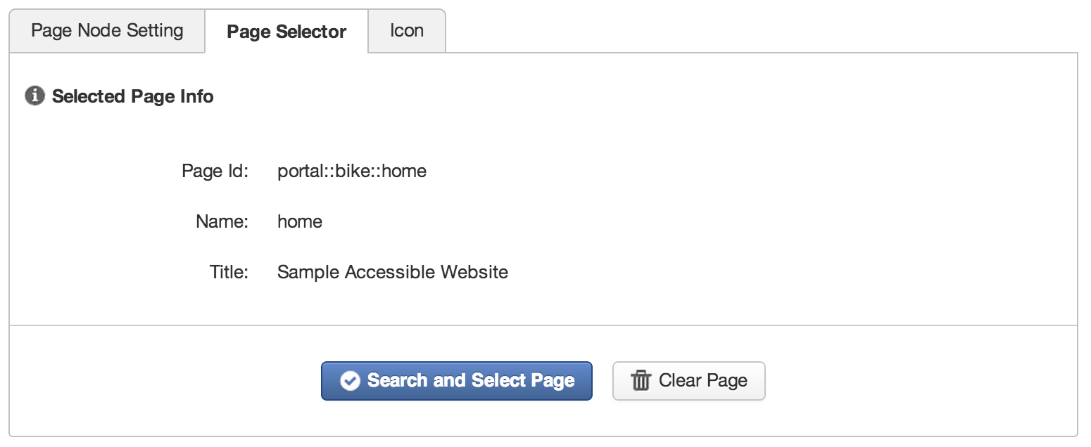
Navigation – Page
Each navigation node is assigned to a page.
You create a new page or select an existing one.
You can point to same page from different navigation nodes.

Slide 43
Portal Summary
A portal is a set of pages and navigations and some properties.
A page is a set of containers, applications and some properties.
A container can contain applications and/or other containers.
The navigation is node based.
A page can be referenced by many navigation nodes.

Slide 44
Exercise

Slide 45
Exercise 1/2 : Site Navigation (15 minutes)
Create a new page, find it in the navigation and create new navigation
New Site Page
Login as John.
Open a site page.
Click on “Edit > Page > Add Page” and browse to the root of the navigation (gray arrow).
Add at least one application to the page (otherwise it won’t show up). Save.
Site Navigation
Click on “Site” in the Admin Tool Bar and open the navigation of your site.
Verify the existence of your new navigation node and page.

Slide 46
Exercise 2/2 : Site Navigation
Create a small navigation tree that reuses pages
Each page contains an IFrame portlet configured to show a target site.
Create the new pages “eXoBlog” (http://blog.exoplatform.com/), “eXoHome” (http://www.exoplatform.com/).
The navigation nodes “shortcuts”, “blog” and “eXo” nodes shall reference to the same page “eXoBlog”.
Create the following user navigation:
eXo
Blog
eXo Home
Note that several navigation nodes can point to the same page.
Your marketing boss asks to change the navigation:
Interchange the order of the subtrees eXo and Shortcuts
Cut and paste “eXo Home” from “eXo” to “Shortcuts”.

Slide 47
Application Registry Portlets and Gadgets administration

Slide 48
Application Registry
An Application can be a Portlet or a Gadget
In the registry you can configure which applications are available to the users.
The available applications appear in the page and portal layout dialogs.
You can define access permissions on category level and for each application.
The user only sees those applications where permissions in both levels are granted.

Slide 49
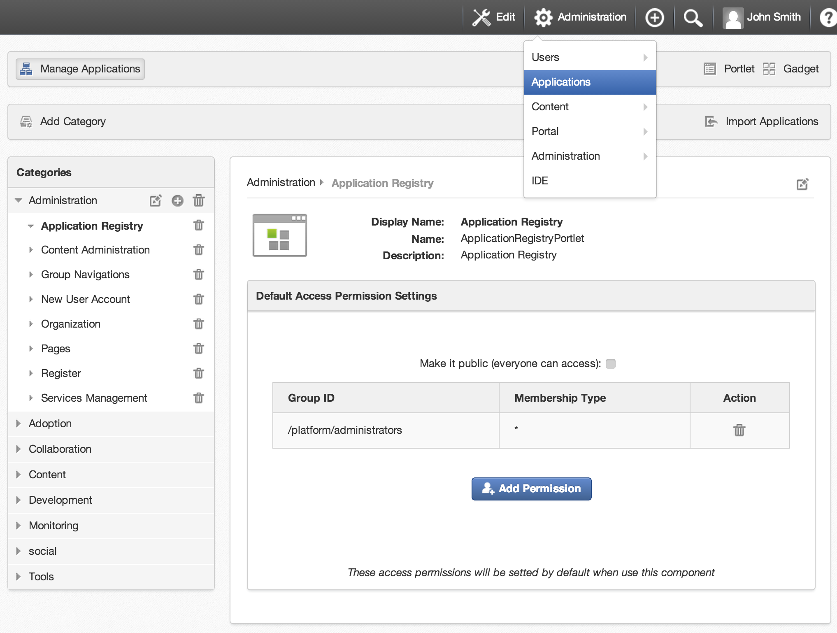
Application Registry
Portlet and Gadgets management
Add Category
Category
Import All available Applications (don’t use this)
Application
Manage Access Permissions on application

Slide 50
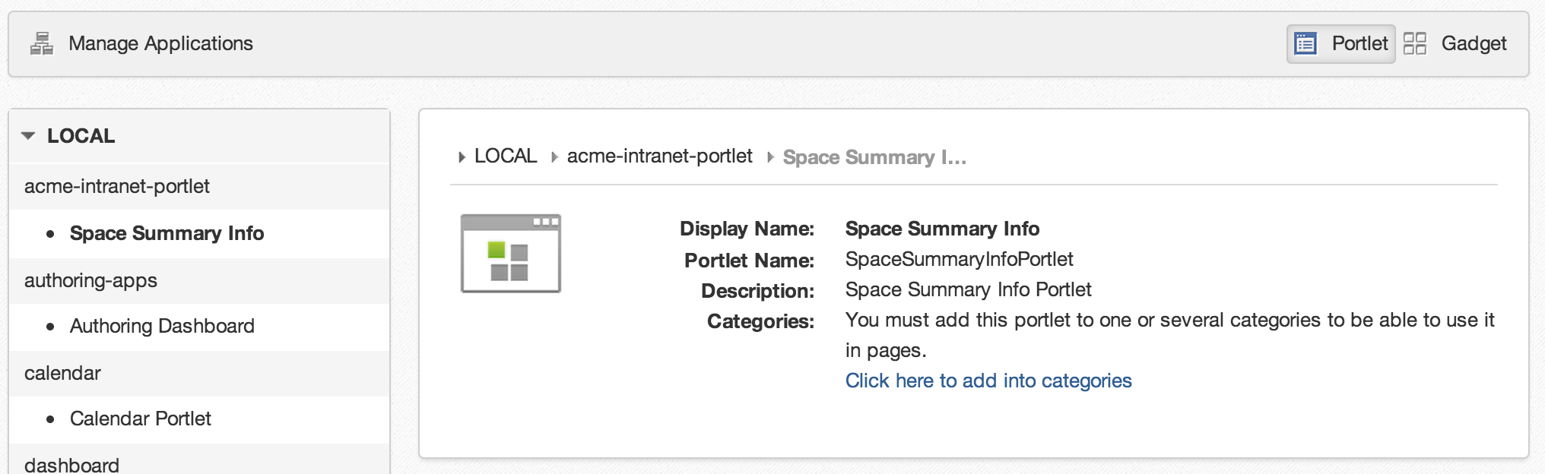
Application Registry - Portlets

Slide 51
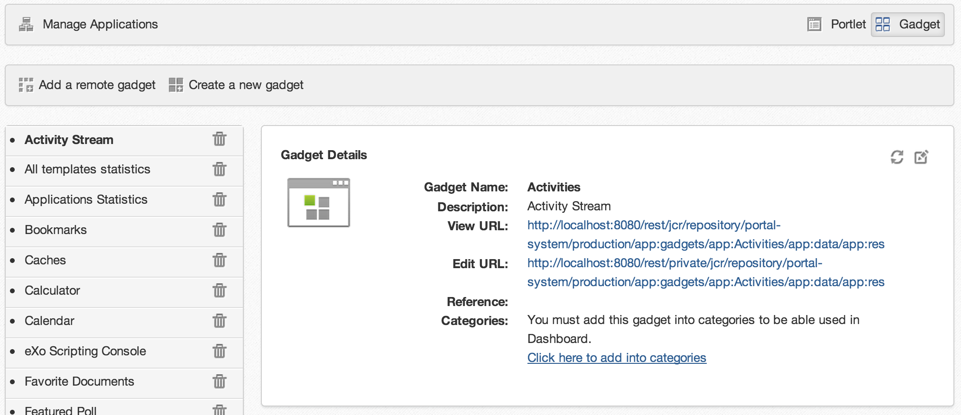
Application Registry - Gadgets
Create a new gadget stored in the Platform
Add a remote gadget by its URL
Add into categories to be able to use gadgets

Slide 52
Exercise

Slide 53
Exercise 1/2 : Application Registry (20 minutes)
Configure
Create a new application category “Bike Applications”.
Add some applications to your category.
Make your category accessible to all users.
Gadget
Switch to the Gadget panel. Create a new gadget.
Modify the gadget code by replacing “hello world” by “toto”. Save and add it to your new category.
Layout
Create a test page, open the layout and test the new category and applications.

Slide 54
Exercise 2/2 : Application Registry
Permissions
Create an application category only accessible for the group “organization/management”.
Open an application in a public category and make it visible only to the management, put this application into a category available to all users.
Login as “elena”,
Click on dashboard
Add new page. Check if there are categories and application that are only accessible to the management.
Logout, login as john, put “elena” in the “organization/management” group
Click on dashboard
Add new page. Check if there are categories and application that are only accessible to the management.
Import
In the Application Registry, click on “Import Applications”

Slide 55
Group Sites and Navigations « one site per group »

Slide 56
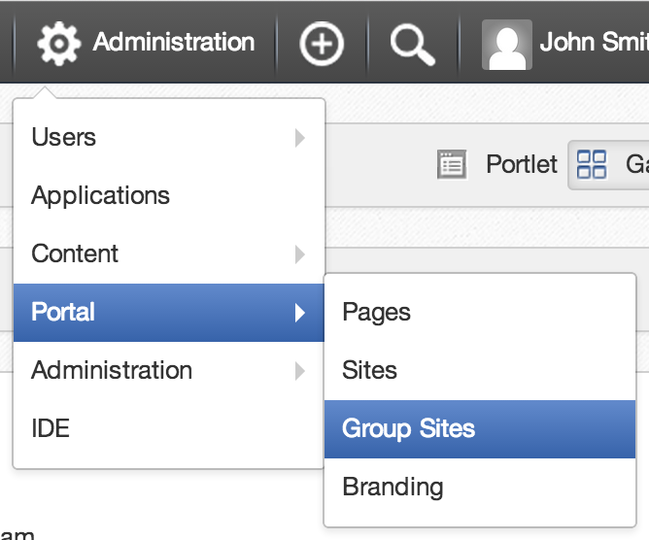
Groups
There can be a portal for each group. Portal = layout + pages + navigation
Each user belongs to one or several groups.
You see the navigations and pages of your groups in the Admin Tool Bar.
Only those users with the role “manager” can modify the navigation of a group.

Slide 57
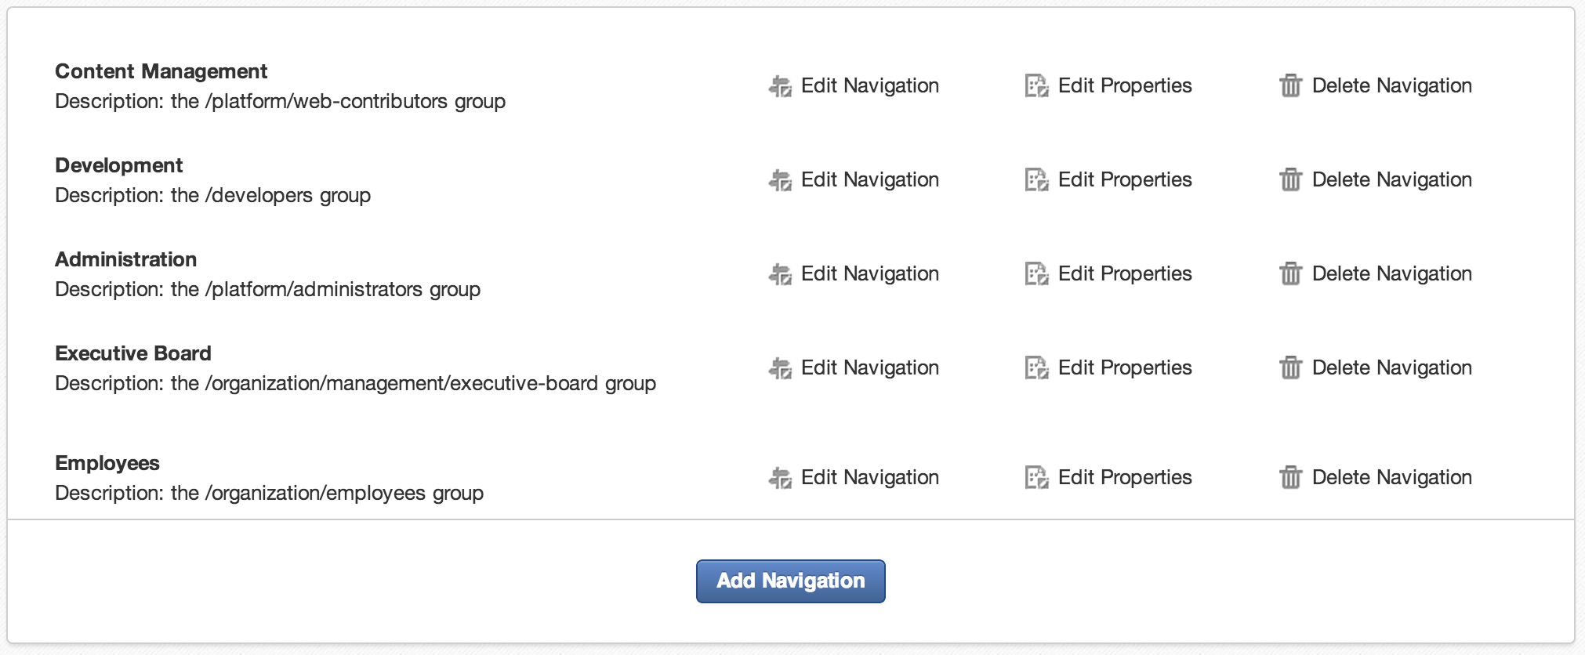
Groups
You see all groups where you have the “manager” role, but only those which already have navigation.
You can add new navigations for groups where have the “manager” role.
Group with navigation and where the connected user has the role “manager”
Add a group to this list that does not have navigation nodes yet.

Slide 58
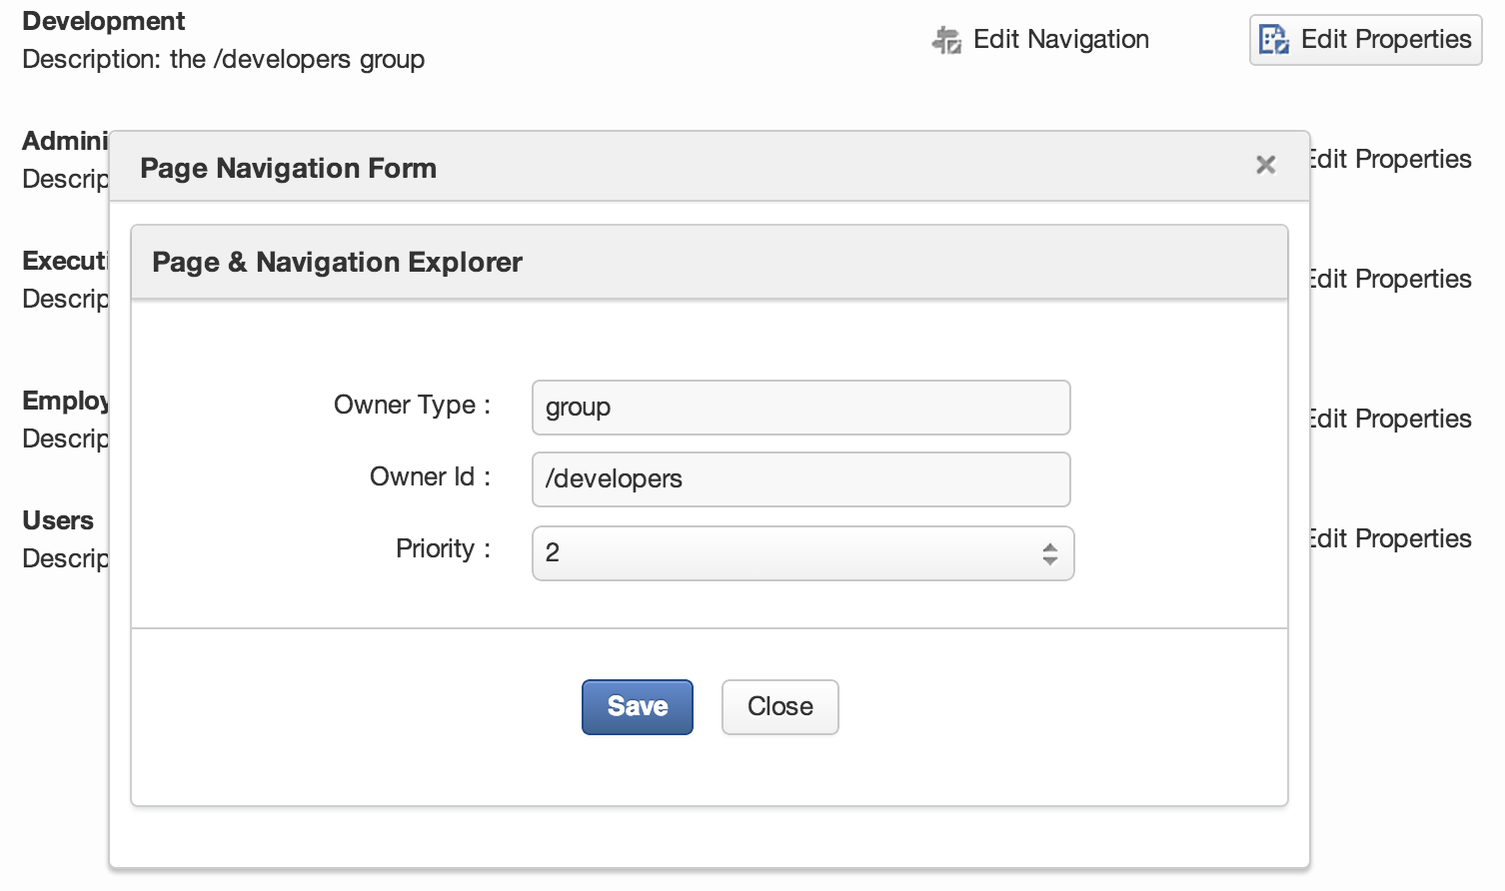
Groups
By clicking on “Edit Properties” you can define the order of the group navigations in the menu.
You can define the order of group navigations by priority.

Slide 59
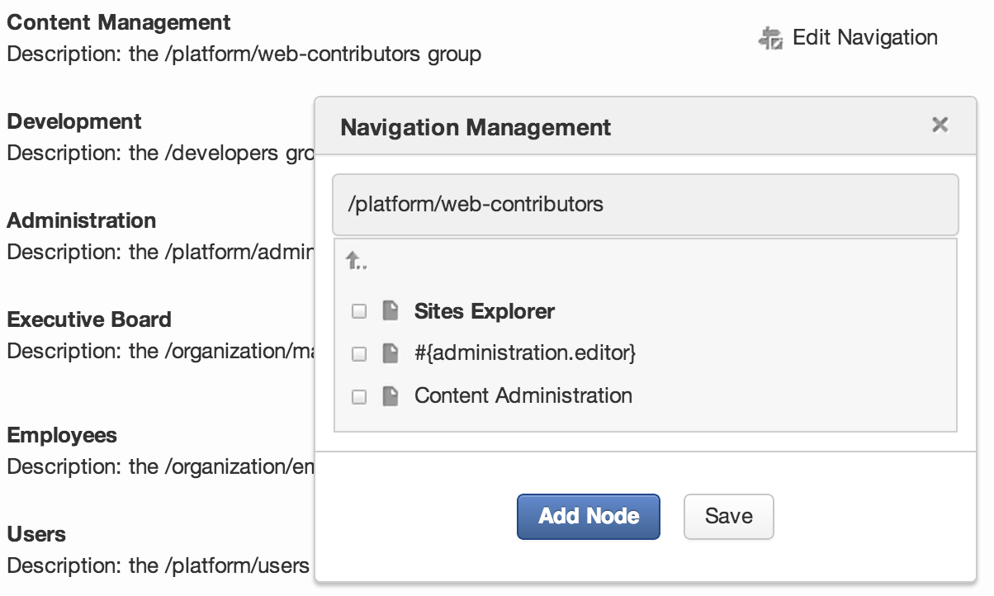
Group Navigation
Navigation of the group Content Management

Slide 60
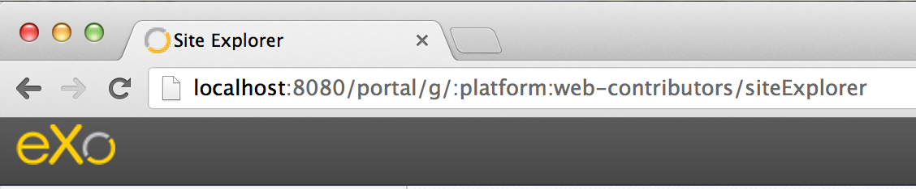
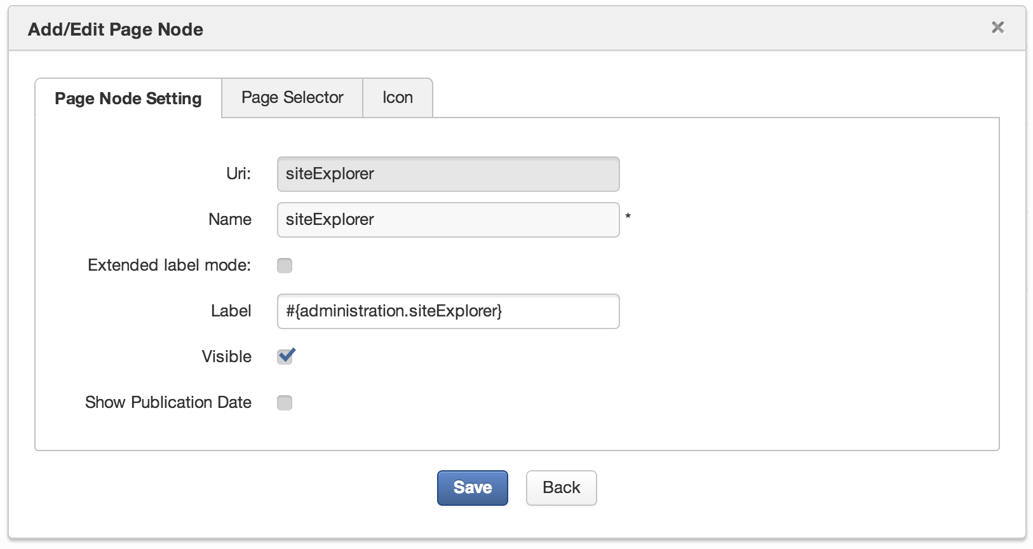
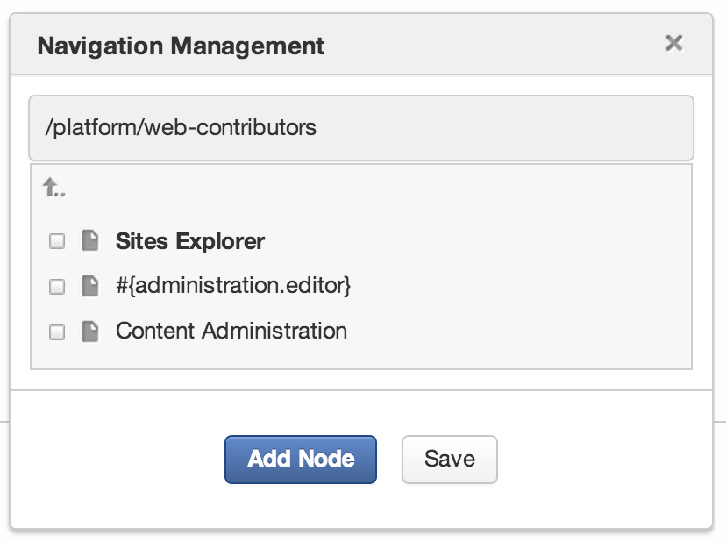
Group Navigation

Slide 61
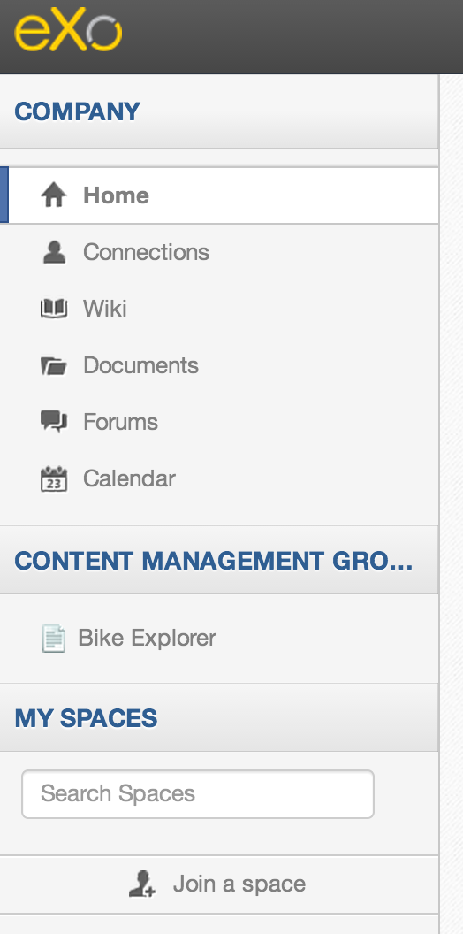
Group Navigation
New Group Navigation go in the Left navigation

Slide 62
Exercise

Slide 63
Exercise 1/2 : Group Navigation (15 minutes)
Create a new page in a group, create pages accessible for platform/bike only, modify the layout of this group’s pages.
New Group Page
Login as John. Open a group page of platform/administrators. (like Add User)
Click on “Edit > Page > Add Page” and browse to the root of the group navigation (top arrow).
Add at least one application to the page (otherwise it won’t show up).
Save.

Slide 64
Exercise 2/2 : Group Navigation
Groups Navigation
Click on “Portal → Group Sites” in the Admin menu and open the navigation of platform/administrators.
Verify the existence of your new navigation node and page.
Make john a manager of the group “platform/bike”. Add a navigation to the group platform/bike. Add two new navigation nodes to the group, select any existing page or create new pages.
Group Layout
Click on a page of “platform/administrator and modify the portal layout for all pages of this group (“Edit Layout”).
Modify also the layout of the platform/bike group portal.
Switch between the pages of the bike group in order to see the differences.

Slide 65
Examples

Slide 66
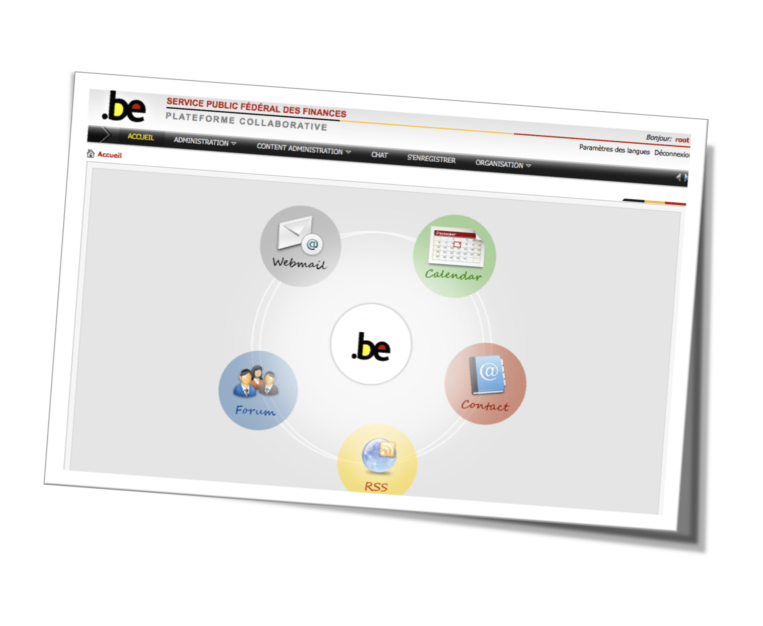

Slide 67
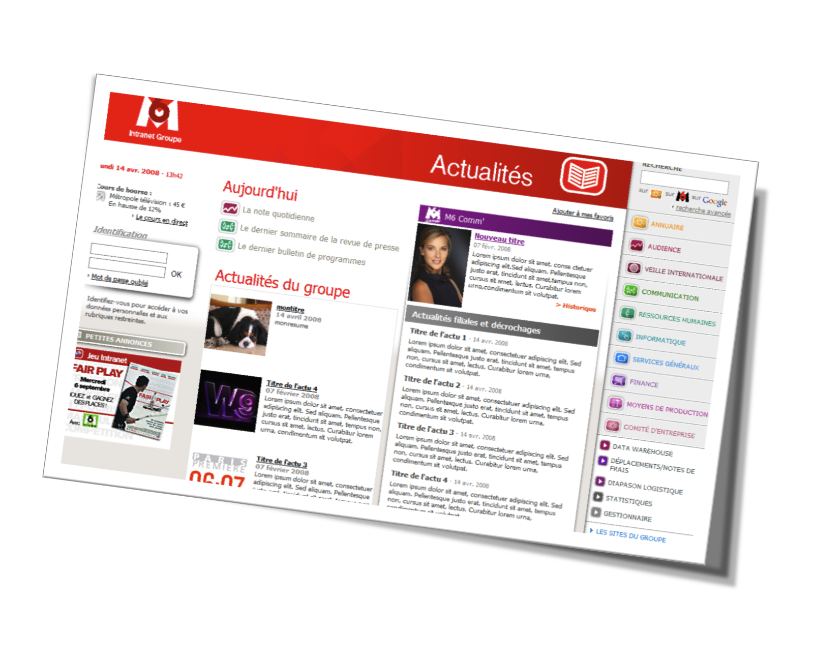

Slide 68
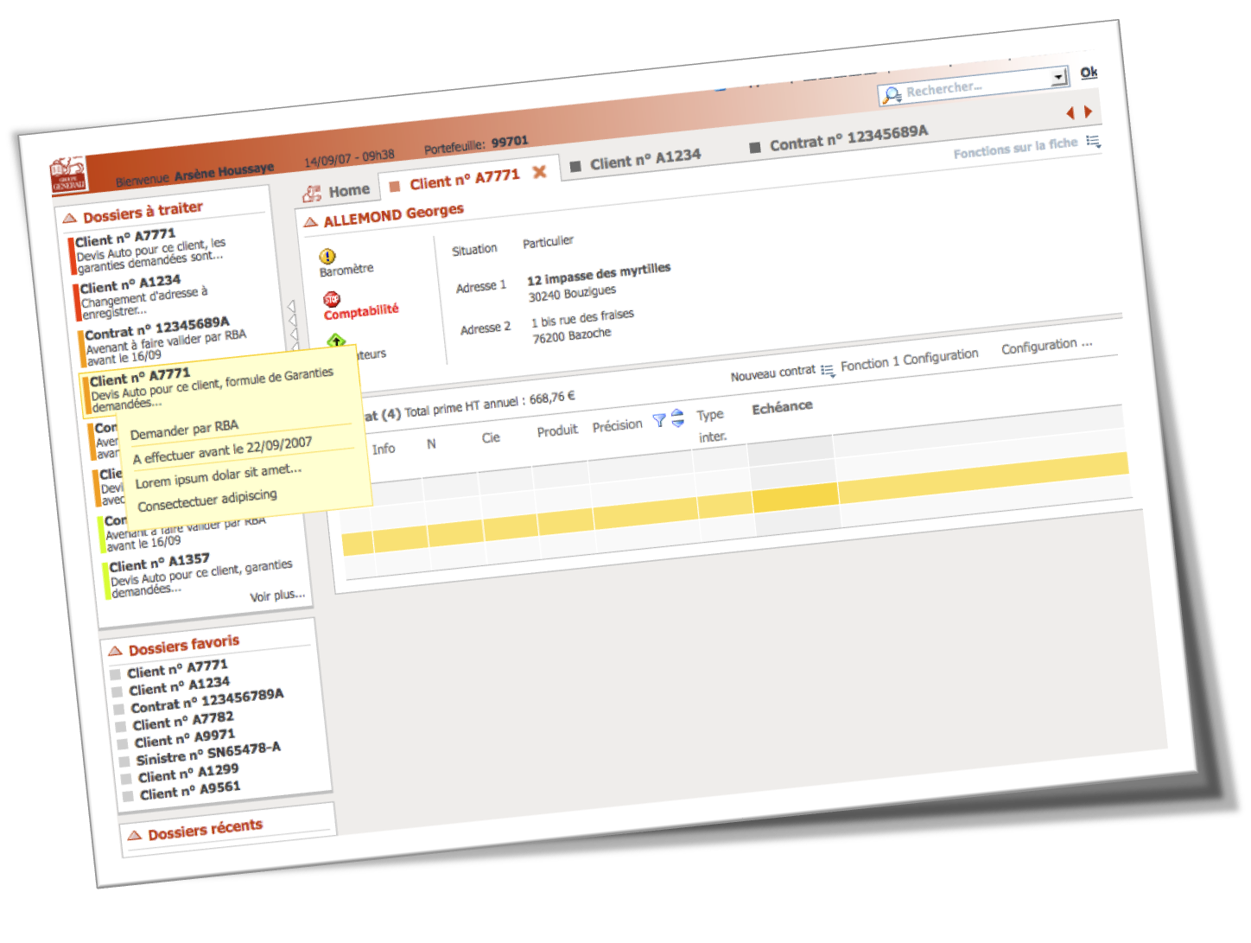

Slide 69


Slide 70
Portal Advanced Features
Sites, Layouts, Navigation, Portlets
Questions and answers

